Slide 1

Flask App In-Class Exercise
A semester’s worth of material in 30 minutes or less for you to copy-pasta
CS411 Spring 23
Peter B. Golbus

Slide 2

Web Server Gateway Interface?

Slide 3
What is Flask?
Flask is a Python micro web framework
It generates http responses and nothing else

Slide 4
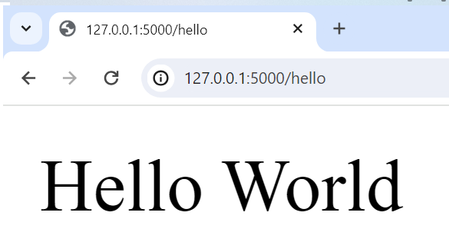
Anatomy of hello world
route
from flask import Flask
app = Flask(__name__)
@app.route('/hello')
def main():
app.logger.info("Hello world")
return "Hello World", 200
if __name__ == "__main__":
# to run me from the command line: <flask --app main run> or <python app.py>
#
app.run(host='0.0.0.0', port=5000, debug=True)
app
host

Slide 5
Layout of a flask app
webapp/
| webapp/
| | __init__.py
| | utils.py
| | logger.py
| | webapp_model.py
| static
| | css
| | | style.css
| | javascript
| | | webappView.js
| | images / assets / whatever
| templates
| | index.html
| app.py
| requirements.txt
| requirements.lock

Slide 6
Requirements.*
Top level requirements for a human
requirements.txt
All requirements for deployment
requirements.lock
Flask==2.2.3
click==8.1.3
Flask==2.2.3
importlib-metadata==6.0.0
itsdangerous==2.1.2
Jinja2==3.1.2
MarkupSafe==2.1.2
mysql-connector-python==8.0.32
protobuf==3.20.3
Werkzeug==2.2.3
zipp==3.15.0

Slide 7
Virtualenvs
DON’T INSTALL DEPENDENCIES INTO YOUR SYSTEM PYTHON ENVIRONMENT
python -m venv /path/to/new/virtual/environment
source /path/to/new/virtual/environment/bin/activate
pip install –r requirements.lock
When you are done
deactivate

Slide 8
But just do this
Setup python, pip, virtualenv and virtualwrapper, with zsh on a new machine (github.com)

Slide 9
Installing requirements with pip
Install requirements
pip install flask
Generate lock file
pip freeze > requirements.lock
Install from file
pip install –r requirements.lock

Slide 10
Injecting HTML with Jinja2 templates
{{ variables }},
{% if conditionals %}
{% for loops in lists %}
Not really a frontend / backend. This is all backend

Slide 11
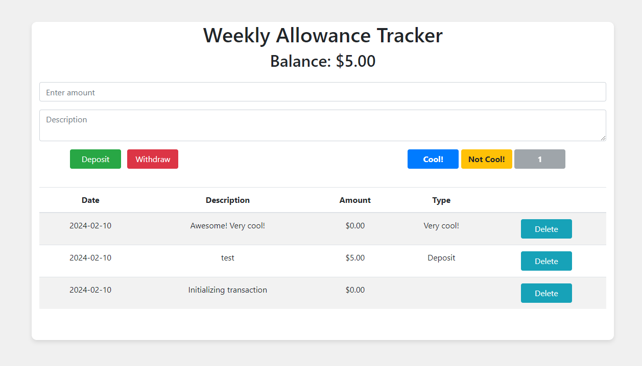
Allowance app
Webview in front of a db table
SQLite is a rdbms that stores small databases in flat text files
Constants stored in .env file
People have the weirdest hobbies

Slide 12
Dynamic HTML with jQuery*
* This is a really outdated way to do this, but React / Vue / Angular require setup. This we can just use
Problem: Encapsulation of concerns
I don’t want my microservice drawing pictures
Templating: inject dynamic results into response
AJAX: dynamically update HTML in the client

Slide 13
Mastermind
Pure jinja2 template (font-size 3) Re-render index every time
Jinja2 template for jQuery (font size 6)
Load index once and update dynamically
<table id="guessTable" class="moveTable">
<tr>
<td>Move</td>
{% for index in range(size) %}
<td>Color {{ index + 1 }}</td>
{% endfor %}
<td>Correct Position</td>
<td>Correct Color</td>
</tr>
{% for guess in guesses %}
<tr>
<td>{{ loop.index }}</td>
{% for color in guess[:size] %}
<td style="background: {{ pattern_colors[color] }}"></td>
{% endfor %}
{% for result in guess[size:] %}
<td>{{ result }}</td>
{% endfor %}
</tr>
{% endfor %}
</table>
{% if win %}
<div>
You won in {{ guess_count }} guesses!
</div>
{% elif lose %}
<div>
You lose!
</div>
{% else %}
<div id = selectDiv>
<form action="guess" method="post">
<table>
<tr>
{% for index in range(size) %}
<td>Color {{ index + 1 }}</td>
{% endfor %}
</tr>
<tr>
{% for index in range(size) %}
<td>
<select id="color{{ index + 1}}" name="color{{ index + 1 }}">
{% for color in pattern_colors %}
<option name="{{ color }}" value="{{ loop.index - 1}}">{{ color }} </option>
{% endfor %}
</select>
</td>
{% endfor %}
</tr>
</table>
<button type="submit">Guess</button>
</form>
</div>
{% endif %}
<form action="reset" method="post">
<button type="submit">Reset</button>
</form>
</div>
<table id="guessesTable">
<tr>
<td>Move</td>
{% for index in range(size) %}
<td>Color {{ index + 1 }}</td>
{% endfor %}
<td>Correct Position</td>
<td>Correct Color</td>
</tr>
</table>
<div id="selectDiv">
<table id="selectTable">
<tr>
{% for index in range(size) %}
<th>Color {{ index + 1 }}</th>
{% endfor %}
</tr>
<tr>
{% for index in range(size) %}
<td>
<select id="color{{ index + 1}}" name="color{{ index + 1 }}">
{% for color in pattern_colors %}
<option name="{{ color }}" value="{{ loop.index - 1}}">{{ color }} </option>
{% endfor %}
</select>
</td>
{% endfor %}
</tr>
</table>
<button id="guessButton">Guess</button>
</div>
<div id="endGameDiv"></div>
<div id="resetDiv">
<button id="resetButton">Reset</button>
</div>

Slide 14
De-Coupled Web Architecture
jQuery API calls
Flask routes
jQuery HTML updates
Python game logic

Slide 15
Concentration / Mastermind 2 ways
You are given
Python model
jinja2 template (blank for pure backend mastermind)
app.py with all Flask removed
js view with API calls unimplemented
Go nuts. Pair programming encouraged

